Slide 1
Cost of living analysis (Power Bi)
Mentorness
Deepika G

Slide 2
Abstract
This project revolves around the analysis of the cost of living in various cities and countries across the globe. The dataset used for this analysis encompasses a wide range of economic indicators, from the price of basic commodities to the cost of housing, transportation, and even entertainment. By harnessing the power of Power BI, we aim to gain valuable insights into the economic disparities between different regions and understand the factors that contribute to the varying costs of living. This project serves as an exercise in data visualization, analysis, and interpretation, offering a comprehensive view of the world's economic landscape.

Slide 3
PROBLEM STATEMENT
The cost of living is a crucial metric that impacts individuals and businesses alike. Understanding the cost of living in different cities and countries is vital for making informed decisions regarding relocation, investment, or business expansion. This project aims to address several key questions:
• What are the cities and countries with the highest and lowest costs of living?
• What are the major cost components contributing to the overall cost of living in a region?
• How do factors like average salary, housing costs, and transportation expenses correlate with the cost of living?
• Are there any trends or patterns in the data that can help individuals and organizations make strategic decisions?

Slide 4
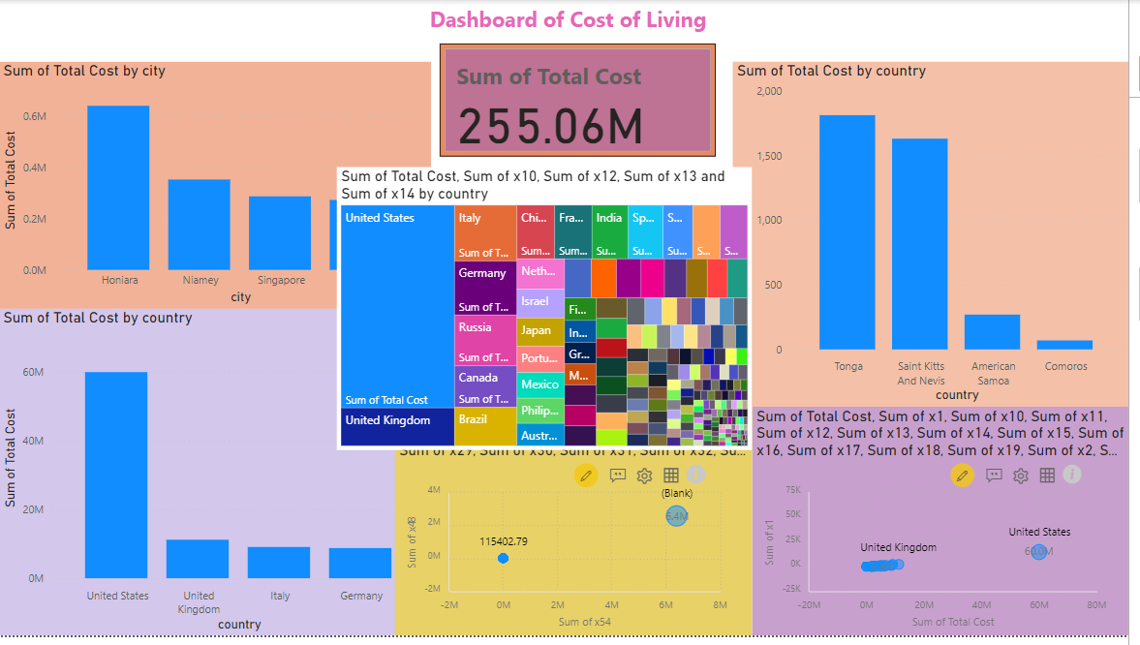

Slide 5
THANK YOU

